Slide 1
EU-wide studies on the integration of
renewable energies in the electricity grid
F. Wagner, IPP Greifswald
1
Exemplified first
on the basis of German data
then with EU-wide data
Germany
Load:
varies between 80 and 40 GW
RES 2014:
installed wind power: ~ 35 GW installed PV power: ~ 35 GW

Slide 2
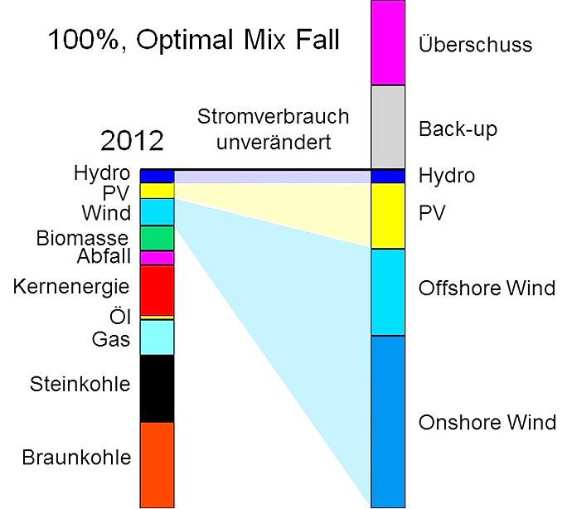
EU-wide studies on the integration of
renewable energies in the electricity grid
F. Wagner, IPP Greifswald
2
Sources for electricity
– today and „tomorrow“
Exemplified first
on the basis of German data
then with EU-wide data
Germany
Load:
varies between 40 and 80 GW
RES 2014:
installed wind power: ~ 35 GW installed PV power: ~ 35 GW
100%, optimal mix case
level of
consumption
unchanged
500 TWh

Slide 3
Method and assumptions
3
Method:
Take load-, wind-, PV-… data from 2012 and scale the intermittent RES
to higher capacities e.g. to the 100% case )
Assumptions:
no savings in electricity consumption
hydro remains the same, subtracted from load →
no nuclear power
no biogas
no losses
The mix of wind and PV follows the
optimal mix: ~ 80% energy from wind, ~20% energy from PV
100% case
reduced load
optimal mix

Slide 4
Topics:
4
How much RES power has to be installed? The remaining need for back-up power? The extent of surplus energy? Dimensioning storage? The dynamics of the back-up system? The conditions for DSM (demand-side management)? | The amount of CO2 reduction? Conditions of a 100% supply by RES? What could be a reasonable share by intermittent RES? The benefits of an EU-wide use of RES Costs of RES?
Special topics:
Sweden: is it possible to replace nuclear power by wind
Japan: the role of PV with a second demand peak in summer

Slide 5
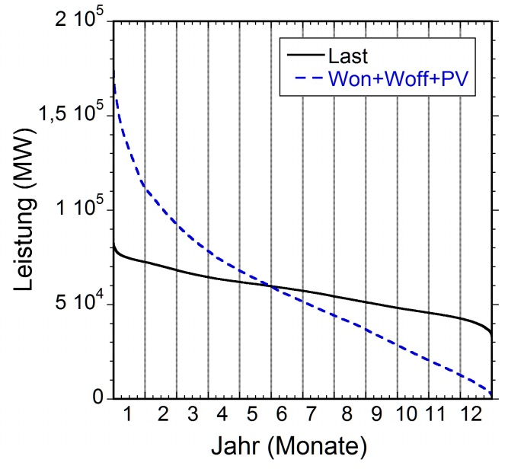
The basic problem of intermittent sources
Annual duration curves of load and wind+PV under optimal mix
load
power (MW)
time (months)

Slide 6
Major Results
6
How much power has to be installed? Enough to serve Europe in good days The remaining need for back-up power? 88% The extent of surplus energy? Formally enough to serve Poland Dimensioning storage? For a 100% case: 33 TWh The dynamics of the back-up system? From 0 up to the load; strong gradients The conditions for DSM (demand-side management)? Cheap electricity prices during the day | The amount of CO2 reduction? Not to the level of France, Sweden... Conditions of a 100% supply by RES? Use of biogas (e.g. 40 TWh) and savings (to 30%) What could be a reasonable share by intermittent RES? 40% The benefits of an EU-wide use of RES? Effects in the order of 20-30% Costs to implement RES? high

Slide 7
Results in more detail: Back-up system
7
Maximum power
of back-up system
power (MW)
Base load
the last 8 weeks in 2012
The power of the back-up system remains high
It has to meet the full dynamic range from 0 to nearly peak load
The power gradients increase strongly

Slide 8
Storage
8
100%, optimal mix case
Jan / Feb 2012
black: load
red: back-up
blue, negative: surplus
power (MW)
Mo 9.1.2012 – Su 12.2.2012

Slide 9
Storage
9
h | 66 | 90 | 117 | 67 | 27 | 71 | 70 | 83
TWh | 3.7 | -3.5 | 4.5 | -2.5 | 0.5 | -2.4 | 0.8 | -3.4
power (MW)
Mo 9.1.2012 – Su 12.2.2012

Slide 10
Storage
10
h | 66 | 90 | 117 | 67 | 27 | 71 | 70 | 83
TWh | 3.7 | -3.5 | 4.5 | -2.5 | 0.5 | -2.4 | 0.8 | -3.4
power (MW)
storage level (TWh)
6
4
2
0
Mo 9.1.2012 – Su 12.2.2012

Slide 11
Storage
11
h | 66 | 90 | 117 | 67 | 27 | 71 | 70 | 83
TWh | 3.7 | -3.5 | 4.5 | -2.5 | 0.5 | -2,4 | 0.8 | -3.4
181
-7.1
power (MW)
storage level (TWh)
6
4
empty
2
0
Mo 9.1.2012 – Su 12.2.2012

Slide 12
Storage
12
h | 66 | 90 | 117 | 67 | 27 | 71 | 70 | 83
TWh | 3.7 | -3.5 | 4.5 | -2.5 | 0.5 | -2,4 | 0.8 | -3.4
181
-7.1
storage level (TWh)
power (MW)
6
4
2
0
Mo 9.1.2012 – Su 12.2.2012

Slide 13
Storage
13
h | 66 | 90 | 117 | 67 | 27 | 71 | 70 | 83
TWh | 3.7 | -3.5 | 4.5 | -2.5 | 0.5 | -2,4 | 0.8 | -3.4
181
-7.1
storage level (TWh)
storage level (TWh)
power (MW)
6
Storage capacity
in the order of
10 TWh
4
2
0
Mo 9.1.2012 – Su 12.2.2012

Slide 14
Storage
14
Need from residual back-up depending on the storage capacity

Slide 15
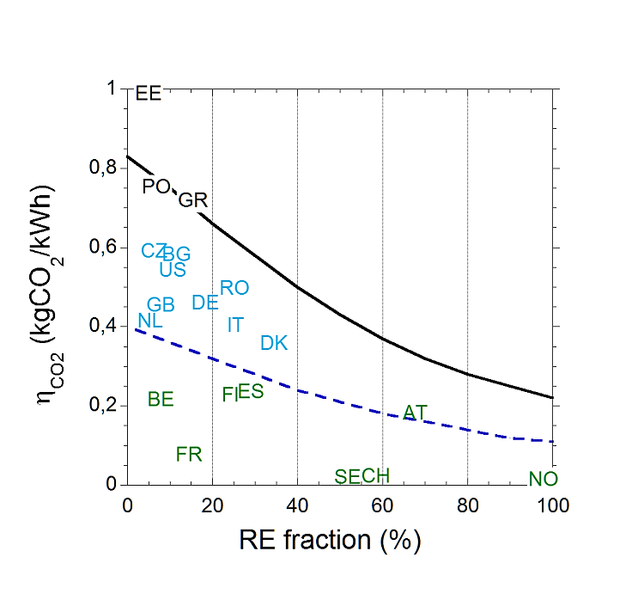
Specific CO2 emission
15
Countries with hydro + nuclear are already where others would like to be in 2050

Slide 16
Specific CO2 emission
16
Countries with hydro + nuclear are already where others would like to be in 2050

Slide 17
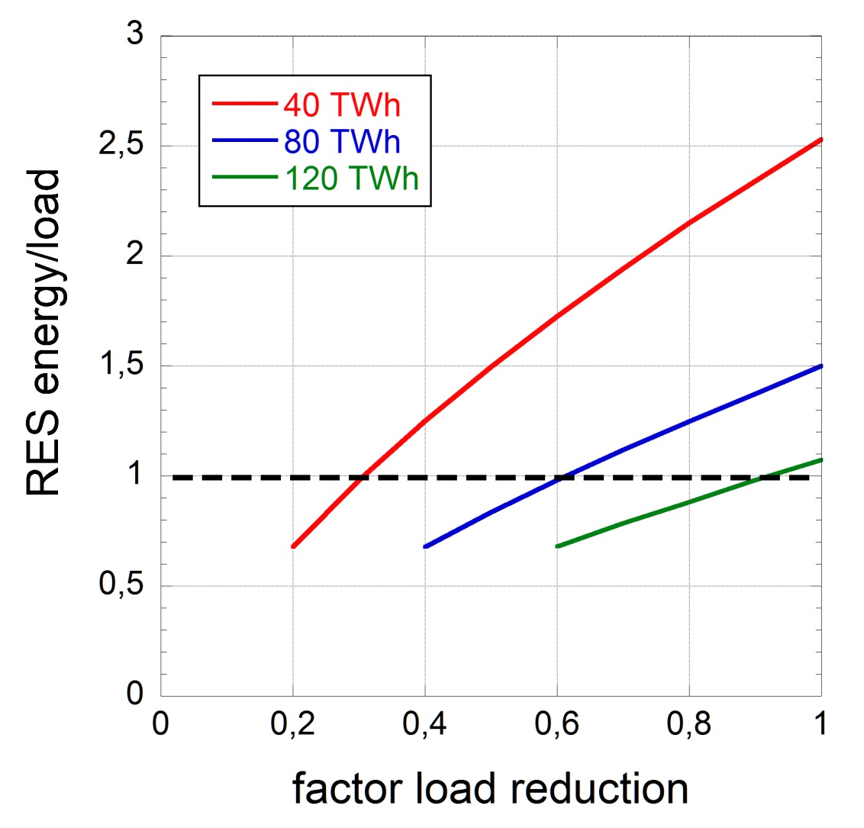
Conditions of a 100% supply by RES
17
Main knobs: savings/efficiency + use of biomass
Minor knobs: decrease of population, import (depatchable power?)
factor of demand reduction

Slide 18
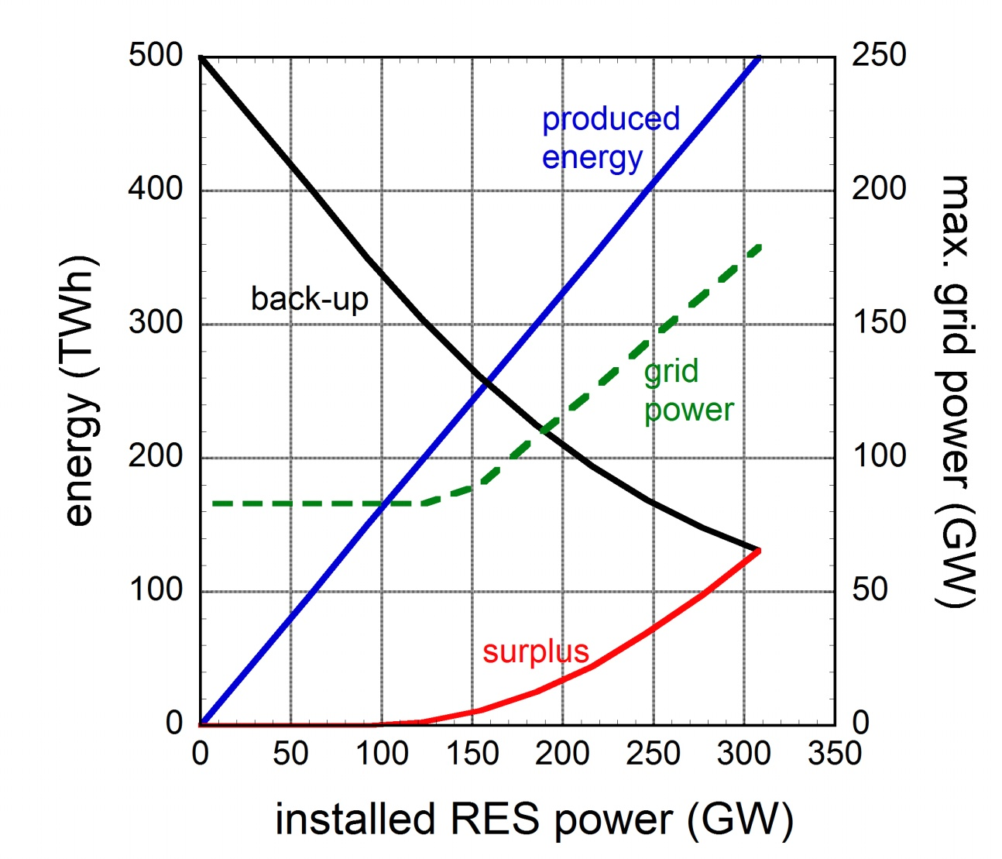
Possible contribution by intermittent sources
18
possible
limit

Slide 19
Benefit from an EU-wide RES field
19
Annual duration curves for German RES field (dashed) and EU-wide RES field
Data from:
Belgium
Czech Republic
Denmark
France
Germany
Ireland
Spain
Sweden
UK

Slide 20
The benefit
20
the back-up energy is reduced by 24%,
the maximal back-up power by 9%,
the maximal surplus power by 15%,
the maximal grid power by 7%,
the typical grid fluctuation level by 35%
the maximal storage capacity by 28%

Slide 21
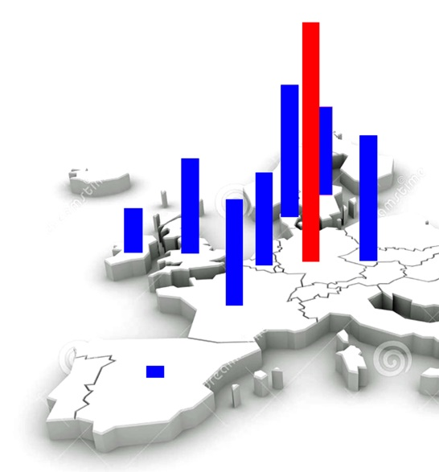
The structure of the EU-wind field
21
normalised surplus
and
„useful“ surplus
wind
correlation
coefficient
100%
UK
Spain
Ireland
Belgium
France
Germany
Denmark
Czech Rep.

Slide 22
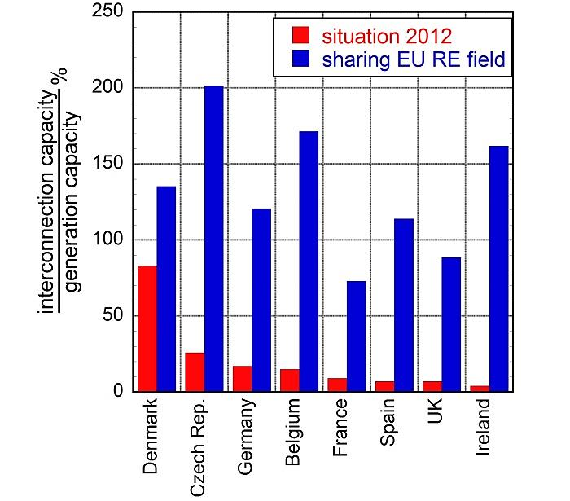
Interconnector capacity
22

Slide 23
Development costs
23
Source: F. Wagner
Finadvice

Slide 24
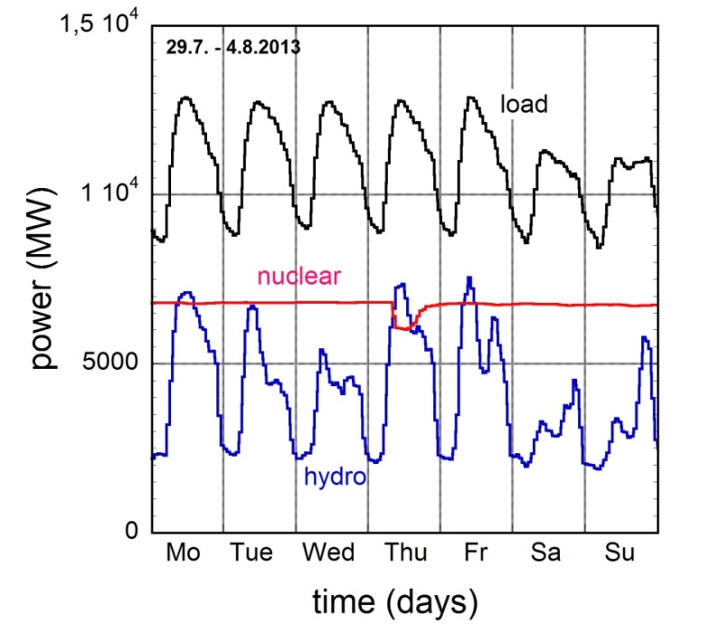
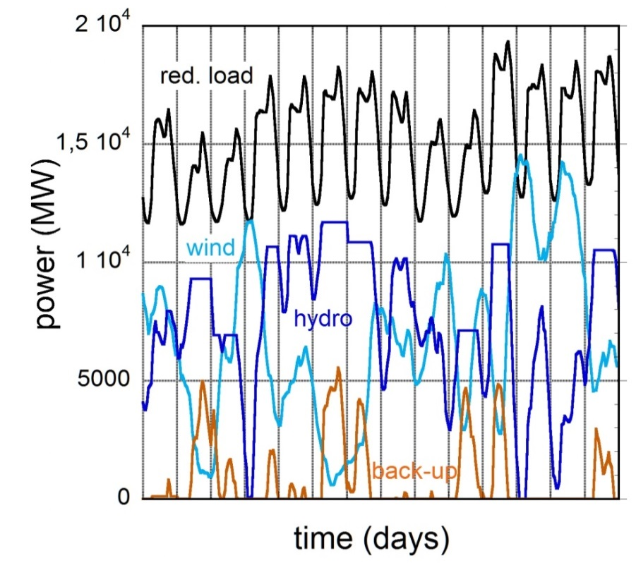
Sweden
24
load | wind | Hydro | Nuclear | Bio-mass
134 TWh | 10 TWh | 62 TWh | 64 TWh | 8.1 TWh
present situation
w/o nuclear power
on the basis of
the first two weeks
in November 2013

Slide 25
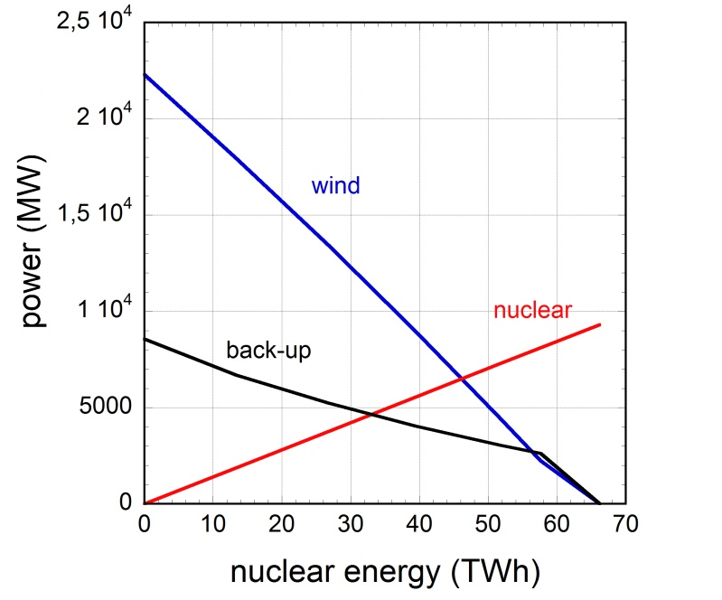
Sweden
25
At constant hydropower:
(1) 9 GW nuclear → 63.8 TWh
or
22.3 GW wind + 8.6 GW back-up → 64,8 TWh.
With gas: Increase in CO2-emission by 50%.
Additional issues:
PV cannot replace the fossil back-up
Too little surplus, thanks to hydropower, to replace the back-up by pumped storage

Slide 26
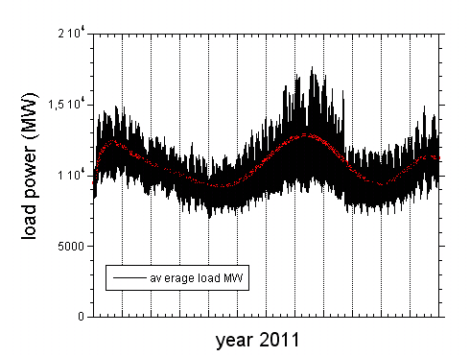
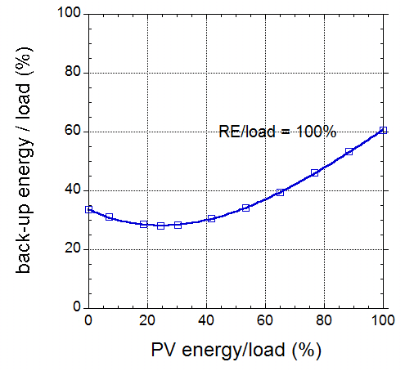
Japan
26
Load variation with
summer and winter peak
The share of
PV power
power (MW)
J F M A M J J A S O N D
time (months)
The second peak – due to summer AC: does not change the optimal mix

Slide 27
Conclusions
Large installations: high costs
Use of landscape
Only 12% savings in back-up
Uneconomic use of back-up (little operation, high maintenance costs)
Technology for large-scale storage not developed
Storage will not be economic
Large price difference between primary and secondary electricity
DMS will force the weekends to be used for economic purposes
Nuclear power is more efficient to reduce CO2 emission
Possibly, 40% of intermittent electricity tolerable: The rest?

Slide 28
The German „Energiewende“
28
Δt: costs
One has to discriminate between
the aims
and the selected route

Slide 29
The German „Energiewende“
29
from red: fossil, nuclear
to blue: wind, PV
Along the way:
Δt: costs
Increase in world population
Increase in energy consumption
Increase of CO₂
Other issues: Oil-peak
Economic disparities
Politically caused shortages
Destruction of supply infrastructure
Breakthroughs in new technologies
now
2050

Slide 30
The German „Energiewende“
30
from red: fossil, nuclear
to blue: wind, PV
Along the way:
Δt: costs
Increase in world population
Increase in energy consumption
Increase of CO₂
Other issues: Oil-peak
Economic disparities
Politically caused shortages
Destruction of supply infrastructure
Breakthroughs in new technologies
Keep all
options open !
now
2050

Slide 31
Mix between wind and PV, onshore and offshore wind
optimal
mix

Slide 32
Demand-side-management
Use weekends!

Slide 33
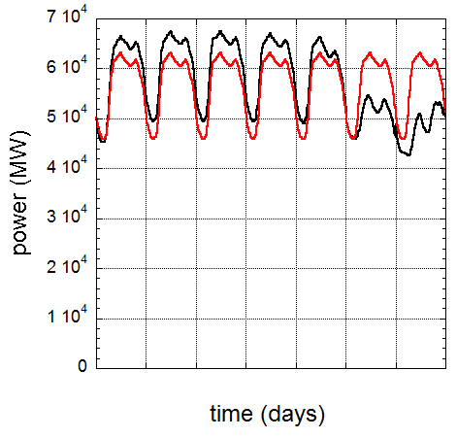
Demand-side-management: use of weekends
33
Full integration of weekends:
Additional use of RE: 7.9 TWh
Peak-load: 83 → 63 MW
Reduction of back-up system:
131 → 123 TWh
Mo
Tue
We
Th
Fr
Sa
Su

Slide 34
Pair of countries | R
Germany-Czech Rep. | 0.53
Germany-Denmark | 0.56
Germany-France | 0.45
Germany-UK | 0.40
Germany-Belgium | 0.39
Germany-Sweden | 0.37
Germany-Ireland | 0.19
Germany-Spain | 0.05

